Slide 1
Economic + Logistic Constraints
Farm size
Location and time fixed effects
Credit available?
Equipment available?
Consider physical constraints
wait
wait
Physical Constraints
wait
latitude
EMBRAPA center pivot locations
Appropriate photoperiod?
Irrigation?
No risk of frost?
plant
wait
‘too late’ to harvest?
Wet season onset from Xavier
Rains are ‘staying’?
Temperature from Xavier
Single or double cropping from land use map
wait
Notes:
How were the Matopiba data collected? Anything about the survey technique that I should know?
Anything else to consider for data to input?
Xavier is ok for rainfall and temp – nothing better?
Surveys: representative sample. Matopiba is a convenient sample, conducted by NGO to get geographically broad region, but within each stratum of region didn’t make sure the interviewees were representative, didn’t talk to enough people. ‘Recall’ survey; didn’t go an measure planting. Prone to recall bias, and not representative.
Every Xavier var except for wind is the best for Brazil (most accurate) – Avery will send paper. Xavier is missing a lot of high resolution temperature stuff that matters. Avery downscaled temperature to be 1km dataset, would be useful far from weather stations.
Xavier precip only has up to 2015, do something else for 2016. CHIRPS? Look at Morgan’s paper about precip datasets.

Slide 2
f (climate and nonclimate variables)
Planting date
Climate variables:
Temperature
Date indicator for end of frost risk
High temperature indicator?
Onset (AA)
Define onset as the date on which:
some threshold of total rain since Aug 1 is reached
a storm of a certain depth is reached
Some rainfall frequency threshold is reached
Nonclimate variables:
Latitude
Memory of previous years’ planting
Irrigation
Trend
Farm size
Average onset over 30 years
Fixed effects for pockets of space and time (credit, equipment, laws)
Interaction variables:
Climate x farm size
Climate x irrigation
Climate x variability in onset
Notes:
Temperature: can we assume it only matters in the South where frost and photoperiod control planting, ignore for other areas?
Temperature: does high temp matter?
If can’t ignore temperature, do some sort of anomalous accumulation for temperature?
Take into account delay due to heavy rain?
New onset definitions: how to set the threshold? Based on regression to AA onset?
Interaction variables – are they ok? Anything else to include?
Onset definitions: try Abrahao approach (modified AA with threshold) – good approach for cropping. Screens out days with too little water depth for germination. Don’t explore a bunch of other onset descriptions.
Have a simpler theoretical framework to show that the relationship is true.
Planting window – include capital constraints too? How much can the fixed effect?
Delay in planting due to too much rain is probably not important; it’s more important for harvest and second crop planting.
No temperature explanatory variable for temperatures too high
Not all nonclimate variables can exist together (e.g. not latitude and unit fixed effects together)
Machine learning with this many variables
Quantile regression – slope is different depending on onset, not as good for predictions
Want to know something about climate during growing year to see whether planting date must change due to onset; some people aren’t sensitive due to their growing season climate
Onset date, expectation of climate (a single index for how long a window you have to plant), fixed effects – do this for each combo of nonclimate vars
How to define expectation of climate – moving window of years
The nonclimate vars: include as sensitivity analysis. Use a dummy variable for different regions and put them in a single regression. Don’t try too many interaction terms.
Onset and planting aren’t hard coupled. Compare agri productivity diffs under hard coupling and soft coupling under climate change. Use climate projections. Planting matters for exposure windows. Also says that the way crop modeling community is handling planting dates is inadequate.
Qualitative rule for when onset is the determinant of planting date in the tropics – so constraint of latitude.

Slide 3
Explore model specifications
OLS regression
plant_{it} = X_{it}β + ε_{it}
De-meaned?
Fixed effects regression
plant_{it} = α_{i} + X_{it}β + ε_{it}
Fixed effects (α_{i}) ‘absorb’ unobservable factors
Notes:
Do OLS with de-meaned variables based on the spatial scale of the fixed effects?
For the each i: a pixel or CAR poly? (depends on resolution of weather data, and also aggregation to polygon)

Slide 4
Explore model specifications
Spatial scale: hierarchically divide data until coefficients ‘stabilize’
All Brazil
Political boundaries/important soy areas (MT, Matopiba, ‘central Brazil’, ‘south’)
200km cells
100km cells
50 km cells (only ~4 weather points in Xavier…)
Temporal subsets at the chosen spatial scale(s): for adaptations and unusual years
Groups of years, consecutive
Individual years
Within each spatial + temporal subset, do model selection
Explore nonlinear functions of onset (polynomial?)
Highest adjusted R2, all coefficients are significant
Test residuals for OLS assumptions, test for multicollinearity
For fixed effects, explore a fixed effect per:
CAR polygon
Municipality
State
Outcome of model exploration:
Appropriate spatial scale for FE and OLS
Appropriate temporal subsetting for FE and OLS (if any)
Fixed effect specification(s)
Notes:
Other ways to group the years? (any special years to think about, economically and politically, that might be useful for grouping?)

Slide 5
Defining sensitivity of plant date to climate
OLS and FE models
Spatial scale(s)
FE specifications
Cross validation
Predictive ability
Model selection
Hypothetical cases
Perturbation in climate
Model of planting date behavior
Change in planting date map
Perturbation in non-climate factors
Notes:
Performance and predictive ability: define across regions and farm characteristics (irrigated, not irrigated)
Perturbations in climate:
Delay in onset by 1, 2, 3, 4 weeks
Increase in temperature
Perturbations in nonclimate factors: explore these?
Planting date across regions if irrigation increases? If farm size increases?
Planting date across regions if economic/logistics constraints change? (how will these be included – a shift in fixed effects?)

Slide 6
Subsets | OLS model selection (demeaned) | FE for each CAR poly | FE for each state | Random forest
All Brazil, all years | Within each subset, choose best combo of vars using: Forward and backward model selection with adjusted R2, p-value Residuals (random? Homoscedastic? Autocorrelated?) Multicollinearity (take one out, see if other coeffs change) – see if each indiv vars are collinear w/ each other Test nonlinear transforms of variables and interaction terms |  |  | Add in ‘dummy vars’ representing each subset Add in T, P (weekly or daily) variables to see if they improve predictions. If so, use random forest alone; if not, ignore them
Five major regions (based on political bounds, ‘soy spots’), all years
200km cells, all years
50km cells, all years
Five major regions, groups of 3 years
Five major regions, each indiv year (ignore trend)
To test predictive ability (and therefore compare OLS vs FE), make sure the new year contains climate that was trained. Can try predictive ability in dry, wet, 50th percentile year, etc.
Subsetting: how do you know what spatial scale creates ‘stability’? look at different scales, plot the coefficient on the y axis and scale on x axis, look at whether there’s a flat part in the curve. If pick a scale, e.g. 50k, do regression for 40km and 60km as well to see whether the coefficients are the same, as a robustness check. Do subsetting hierarchically – within each state, divide into 200km cells, then divide the 200km cells into 50km cells.
Model evaluation/model selection within each model specification
For OLS and FE, choose the largest subset that causes coefficients to stabilize, R2 (hierarchical)
Robustness check: small rescaling after finding ‘best’ scale (50km -> 60, 40 km)
Model selection to compare OLS vs FE
Cross-validation
Test predictive ability (in most recent year, e.g.) – check that the new year contains the climate that was trained; try predictive ability for dry, wet years, etc.
To cope with the fact that response to onset is nonlinear: first do plant = fcn(T, size, etc) and get residuals. Then plot residuals on y axis and onset on x axis and see if onset is linear or not. Can also use separate models for early vs late onset but need to define when the threshold is for late onset (sensitivity test)
Can include a trend, if trend doesn’t exist it shouldn’t matter; the only issue is multicollinearity. Test for it by plotting individual variables against each other to see if they are collinear.

Slide 7
Model diagnostics
Choosing among models | Training | Testing | Notes
Cross validation | All polygons except for one | The polygon that’s missing, given actual weather; repeat and average errors. Report errors for categories (i.e. region, irrig/not irrig, large/small) | ‘how well does the model describe the past?’
Validation for ‘future predictions’ | All years except one | All polygons in the missing year | ‘how well does the model predict future planting for the same farmer?’
Validation for ‘prediction in new soy area’ | all polygons in a certain area | Polygons in another area | Probably won’t work. Won’t have the memory term, and memory is probably a strong expl var. ‘how well does the model predict future planting for a new soy field?’
Choosing within OLS and FE regression:
Everything for choosing among models
Adjusted R2
‘ease of use’ (i.e. lots of regions to choose from?)

Slide 8
Do farmers actually plant before onset?
Single Cropping
% of soy area planted before onset | Mato Grosso | Matopiba | Central | Mato Grosso do Sul, Sao Paulo | South
2003 | 0.04 | 0.05 | 0.2 | 0 | 0
2004 | 0.4 | 0.8 | 0.2 | 0.05 | 0
2005 | 0.09 | 0.2 | 0.5 | 0 | 0
2006 | 0.07 | 0.02 | 0.02 | 0.1 | 0
2007 | 1.8 | 3.6 | 5 | 0.9 | 0
2008 | 0.9 | 0.1 | 0.4 | 0.1 | 0
2009 | 0.08 | 0.06 | 0 | 0 | 0
2010 | 4.6 | 0.1 | 1 | 0.05 | 0.2
2011 | 0.04 | 0.03 | 0.1 | 0.17 | 1
2012 | 1 | 0.9 | 6.4 | 0.18 | 0
2013 | 1.1 | 0.36 | 4.2 | 0.05 | 0
2014 | 8.9 | 1.9 | 8.2 | 0.2 | 0

Slide 9
Do farmers actually plant before onset?
Double Cropping
% of soy area planted before onset | Mato Grosso | Matopiba | Central
2003 | 0.04 | 0.01 | 0.4
2004 | 0.15 | 1.2 | 0.4
2005 | 0.015 | 0.3 | 0.6
2006 | 0.05 | 0.04 | 0.04
2007 | 2.8 | 7.9 | 8.7
2008 | 2.4 | 0.1 | 0.6
2009 | 2.7 | 0.05 | 0
2010 | 13.4 | 0.2 | 1.7
2011 | 0.03 | 0.05 | 0.1
2012 | 1.6 | 3 | 16
2013 | 1.5 | 0.5 | 1.3
2014 | 15.6 | 2.3 | 7.4

Slide 10
Single Cropping
Planting date stays constant while onset changes. This creates a strong delay vs. onset trend (due to onset changing but planting date not changing)
% of soy area planted before onset | Mato Grosso Onset (mean) | Mato Grosso delay (median) | Mato Grosso plant (median)
2003 | 53 | 64 | 42
2004 | 61 | 50 | 45
2005 | 57 | 58 | 44
2006 | 49 | 46 | 49
2007 | 68 | 26 | 48
2008 | 66 | 47 | 45
2009 | 42 | 70 | 45
2010 | 67 | 25 | 47
2011 | 62 | 49 | 45
2012 | 56 | 43 | 44
2013 | 61 | 30 | 46
2014 | 71 | 14 | 46

Slide 11
Double Cropping
Planting date stays constant while onset changes. This creates a strong delay vs. onset trend (due to onset changing but planting date not changing)
% of soy area planted before onset | Mato Grosso Onset (mean) | Mato Grosso delay (median) | Mato Grosso plant (median)
2003 | 53 | 61 | 42
2004 | 61 | 40 | 47
2005 | 57 | 56 | 45
2006 | 49 | 41 | 48
2007 | 68 | 22 | 50
2008 | 66 | 43 | 45
2009 | 42 | 65 | 46
2010 | 67 | 19 | 48
2011 | 62 | 46 | 45
2012 | 56 | 40 | 43
2013 | 61 | 25 | 45
2014 | 71 | 12 | 44

Slide 12
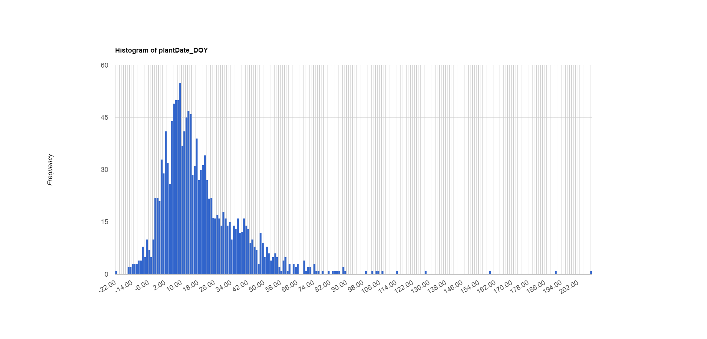
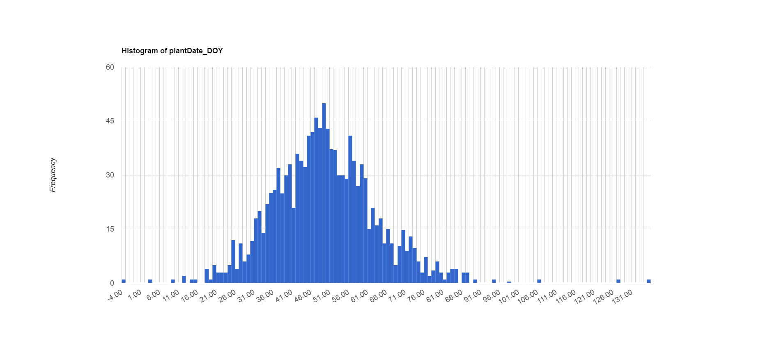
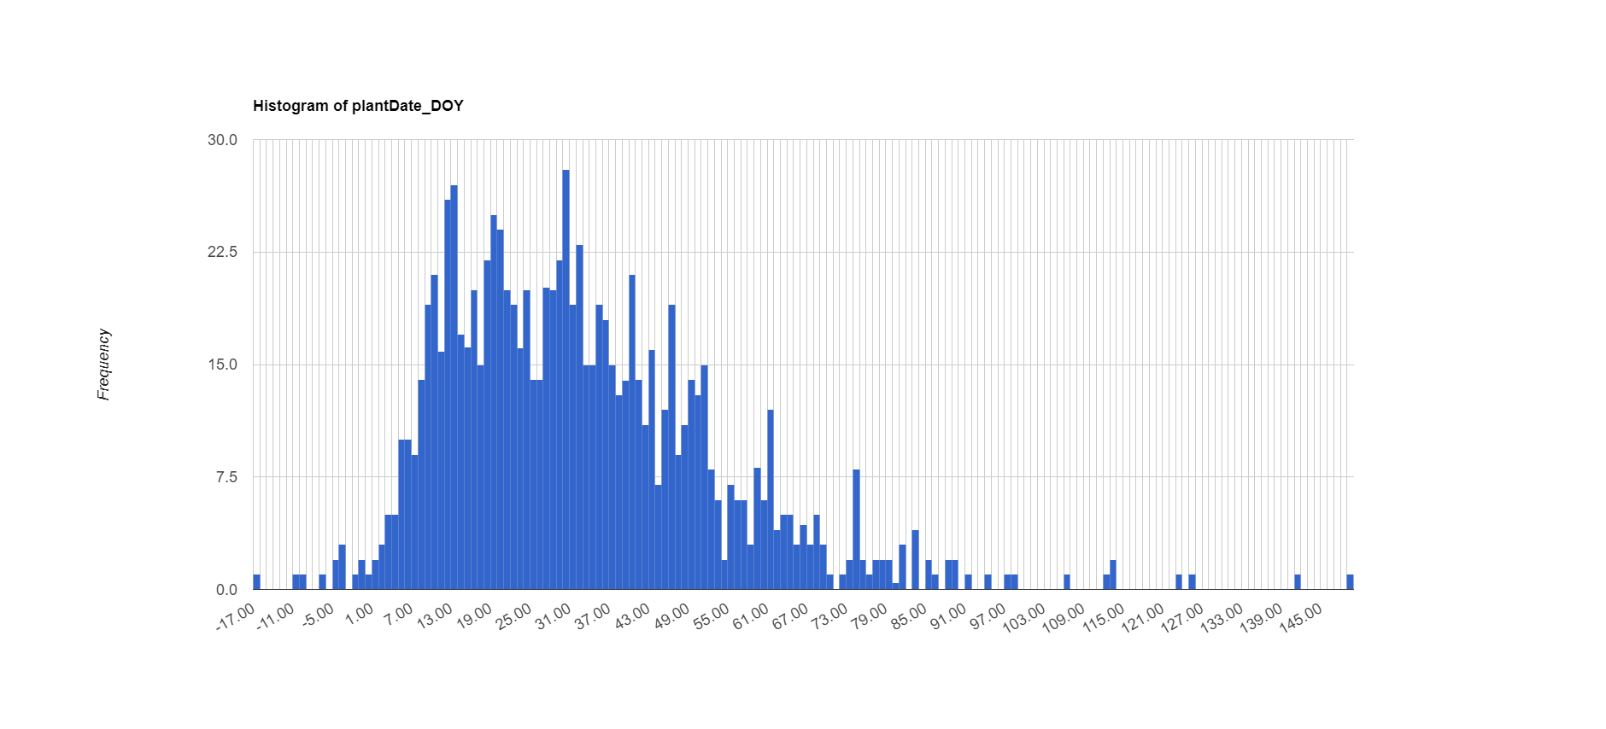
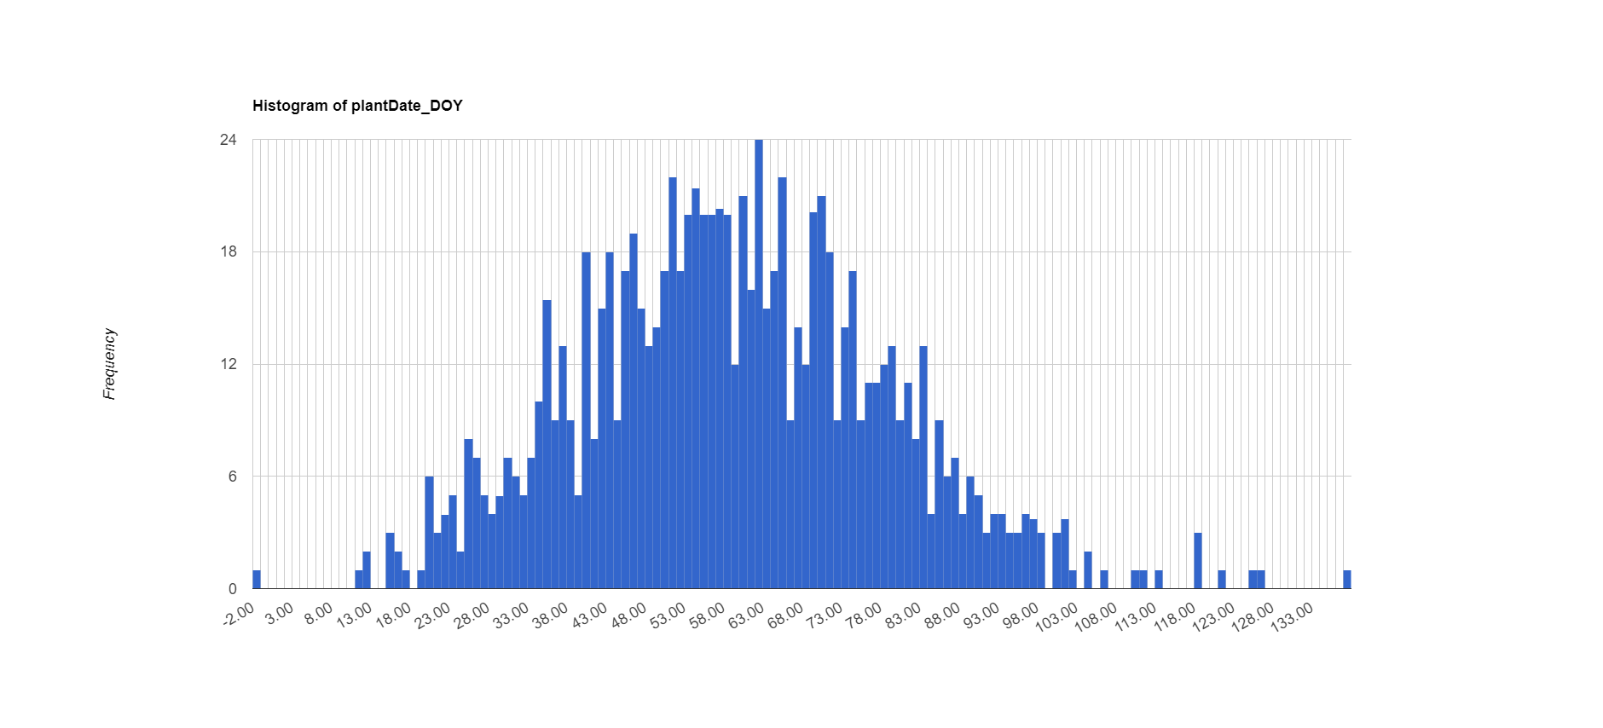
Single Cropping
In Mato Grosso, when onset is late, delay pdf becomes very right skewed even though when onset is earlier, delay pdf is normal. Indicates that farmers are actually good at planting after onset. Here are pdfs of delay in Mato Grosso:
Late onset, delay slams to zero
Early onset, delay is normally distributed
Other areas plant at least a month after onset and so aren’t sensitive at all to changes in onset.

Slide 13
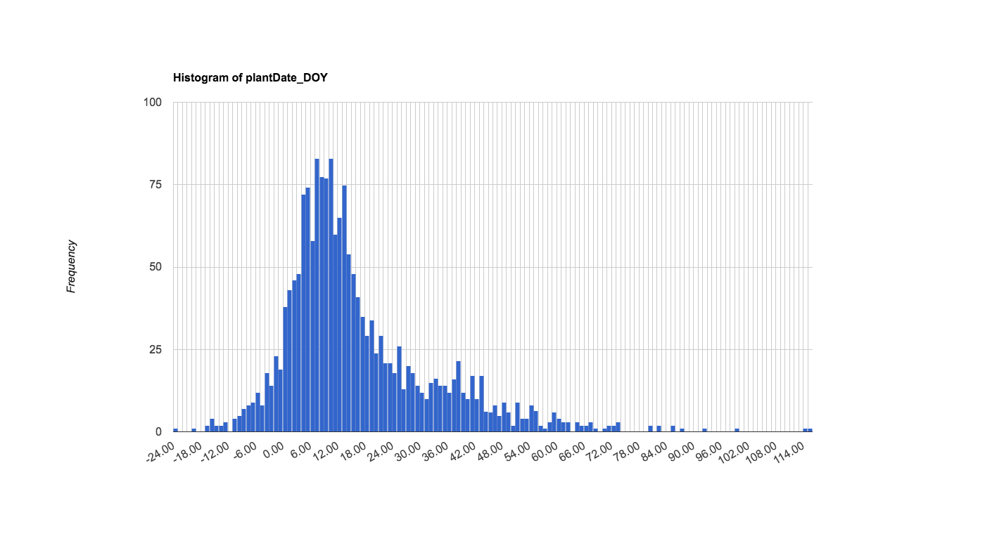
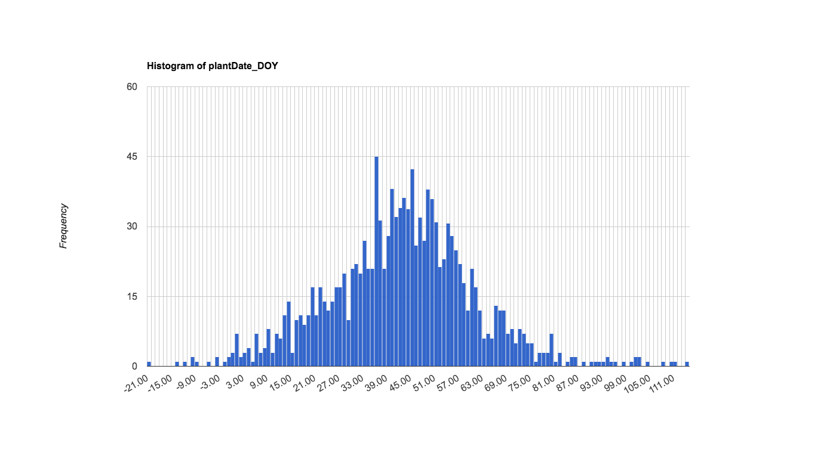
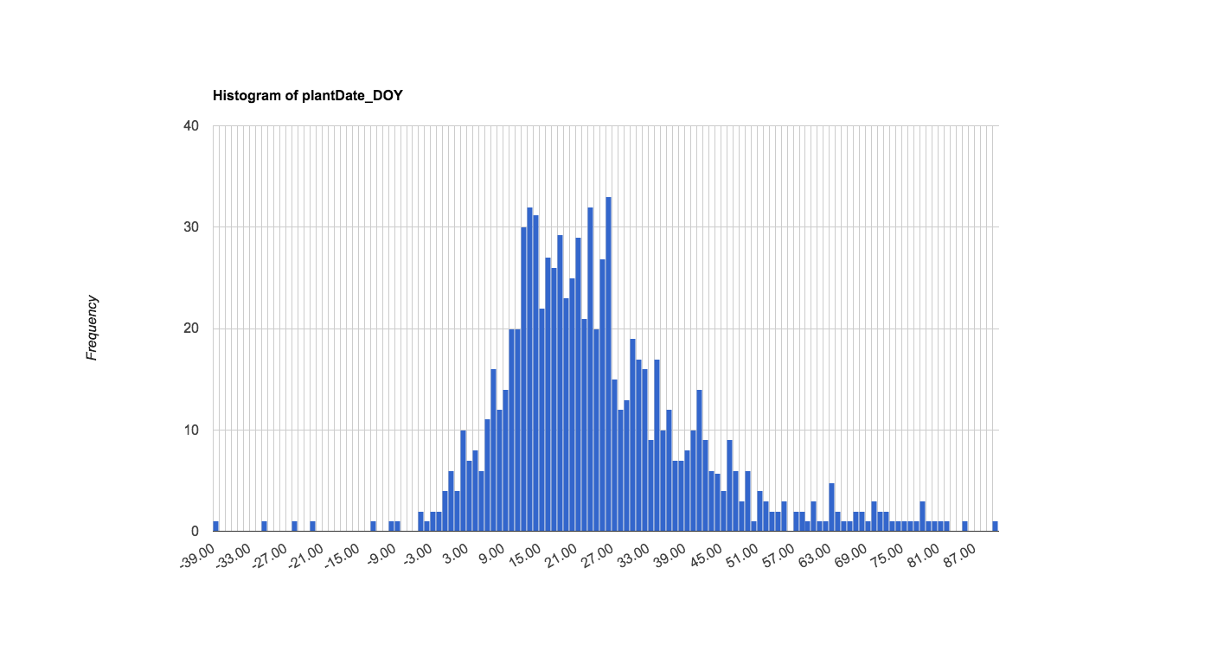
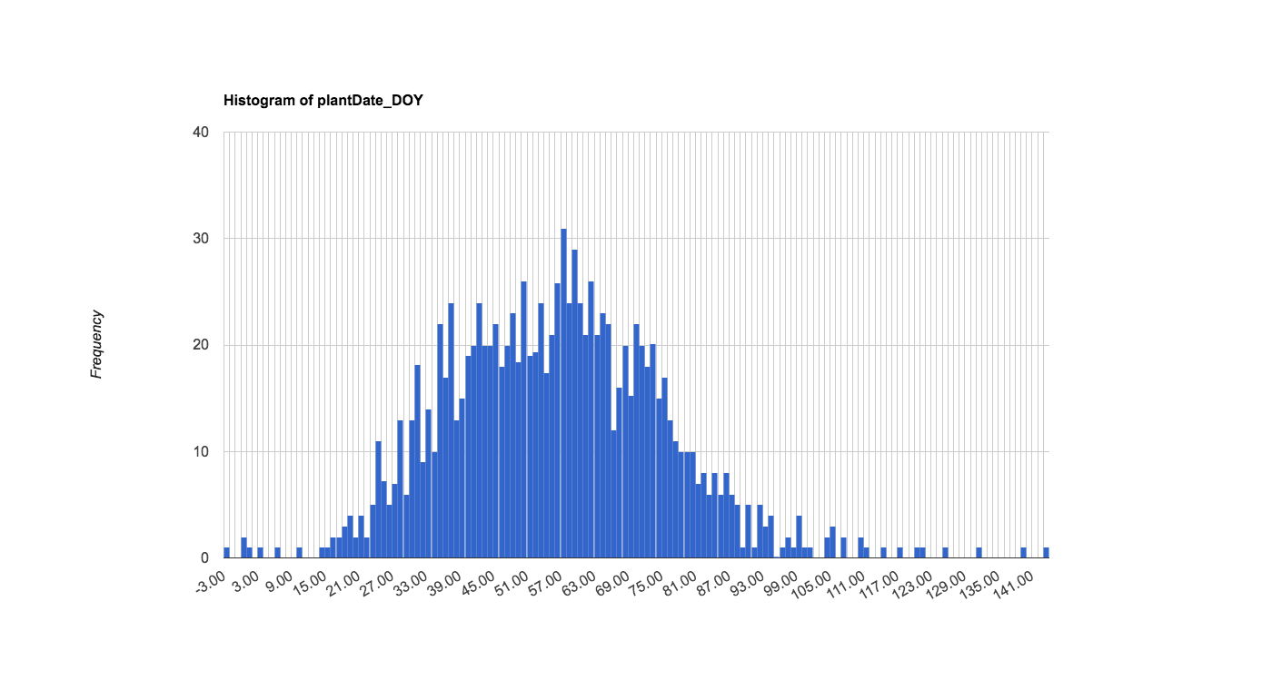
Double Cropping for Mato Grosso
Late onset
Early onset

Slide 14
Single Cropping
Irrigated areas are disproportionately represented in ‘negative delay’
In Mato Grosso, 28% of irrigated areas plant before onset in 2014
In Matopiba, 11% of irrigated areas plant before onset in 2014
In Central, 20% of irrigated areas plant before onset in 2014
In Mato Grosso, the fraction of ‘negative delay’ that’s irrigation is 2.6%
In Matopiba, the fraction of ‘negative delay’ that’s irrigation is 18%
In Central, the fraction of ‘negative delay’ that’s irrigation is 24%
If they plant before onset, they usually plant within 10 days of onset
In Mato Grosso, the fraction of ‘negative delay’ that’s within 5 days of onset is 50%
In Matopiba, the fraction of ‘negative delay’ that’s within 5 days of onset is 52%
In Central, the fraction of ‘negative delay’ that’s within 5 days of onset is 52%
In Mato Grosso, the fraction of ‘negative delay’ that’s within 10 days of onset is 76%
In Matopiba, the fraction of ‘negative delay’ that’s within 10 days of onset is 78%
In Central, the fraction of ‘negative delay’ that’s within 10 days of onset is 78%

Slide 15
Double Cropping
Irrigated areas are disproportionately represented in ‘negative delay’
In Mato Grosso, the fraction of ‘negative delay’ that’s irrigation is 3.1%
In Matopiba, the fraction of ‘negative delay’ that’s irrigation is 19%
In Central, the fraction of ‘negative delay’ that’s irrigation is 23%
If they plant before onset, they usually plant within 10 days of onset
In Mato Grosso, the fraction of ‘negative delay’ that’s within 10 days of onset is 80%
In Matopiba, the fraction of ‘negative delay’ that’s within 10 days of onset is 80 %
In Central, the fraction of ‘negative delay’ that’s within 10 days of onset is 82%

Slide 16
Single Cropping
% of soy area planted before onset | Matopiba Onset (mean) | Matopiba delay (median) | Matopiba plant (median)
2003 | 94 | 49 | 41
2004 | 94 | 53 | 41
2005 | 100 | 45 | 43
2006 | 77 | 72 | 46
2007 | 107 | 26 | 41
2008 | 99 | 43 | 45
2009 | 72 | 71 | 43
2010 | 83 | 53 | 42
2011 | 76 | 68 | 42
2012 | 98 | 40 | 42
2013 | 85 | 59 | 41
2014 | 89 | 46 | 43

Slide 17
Single Cropping
% of soy area planted before onset | Central Onset (mean) | Central delay (median) | Central plant (median)
2003 | 76 | 54 | 42
2004 | 74 | 54 | 41
2005 | 76 | 51 | 42
2006 | 53 | 74 | 46
2007 | 83 | 17 | 48
2008 | 73 | 46 | 43
2009 | 37 | 82 | 43
2010 | 59 | 40 | 45
2011 | 63 | 43 | 47
2012 | 74 | 30 | 44
2013 | 59 | 56 | 43
2014 | 78 | 17 | 46

Slide 18
Single Cropping
% of soy area planted before onset | MTDS and SP Onset (mean) | MTDS and SP delay (median) | MTDS and SP plant (median)
2003 | 53 | 78 | 40
2004 | 65 | 55 | 40
2005 | 44 | 83 | 40
2006 | 35 | 87 | 41
2007 | 77 | 35 | 42
2008 | 54 | 85 | 41
2009 | 17 | 110 | 39
2010 | 53 | 56 | 37
2011 | 61 | 48 | 43
2012 | 55 | 51 | 43
2013 | 52 | 52 | 42
2014 | 51 | 56 | 40

Slide 19
Single Cropping
% of soy area planted before onset | South Onset (mean) | South delay (median) | South plant (median)
2003 | 41 | 97 | 41
2004 | 37 | 100 | 38
2005 | 14 | 102 | 39
2006 | 16 | 128 | 37
2007 | 35 | 80 | 39
2008 | 13 | 122 | 41
2009 | 12 | 137 | 40
2010 | 49 | 99 | 38
2011 | 48 | 123 | 39
2012 | 36 | 78 | 40
2013 | 17 | 107 | 40
2014 | 24 | 102 | 38

Slide 21
What might control planting date?
Legal Constraints
Economic + Logistic Constraints
Phytosanitary law
Credit available?
Equipment available?
Consider physical constraints
wait
wait
wait
Physical Constraints
wait
Irrigation?
Frost?
Appropriate photoperiod?
plant
wait
Rains are ‘staying’?
Favorable forecast?
wait
wait
‘too late’ to harvest?
if include it in prospectus, make sure to tie it to how we account for each of them in the regressions.
Notes:
Do different farmers have different access to forecast?
Could there be adaptations over time (2003-2017) that cause the controls on plant date to change?

Slide 22
Exploratory data analysis to address challenges
Plot for all soy:
Plant date
Driver 1
Driver 2
Driver 3
Is planting date response linear?

Slide 23
Exploratory data analysis to address challenges
Compare plots for individual regions:
Plant date
Driver 1
Driver 2
Driver 3
Is planting date response linear?
At what spatial scales do unobserved effects become uniform?

Slide 24
Exploratory data analysis to address challenges
Compare plots for individual regions and time spans:
Plant date
Driver 1
Driver 2
Driver 3
Is planting date response linear?
At what spatial scales and temporal scales do unobserved effects become uniform?

Slide 25
Exploratory data analysis to address challenges
Compare plots for irrigated vs. not irrigated:
Plant date
Driver 1
Driver 2
Driver 3
Is planting date response linear?
At what spatial scales and temporal scales do unobserved effects become uniform?
Does irrigation make a difference?
Irrigated field
Notes:
Irrigation: any more data other than 2014?
Anything that’s correlated to irrigation but not with any other variable?

Slide 26
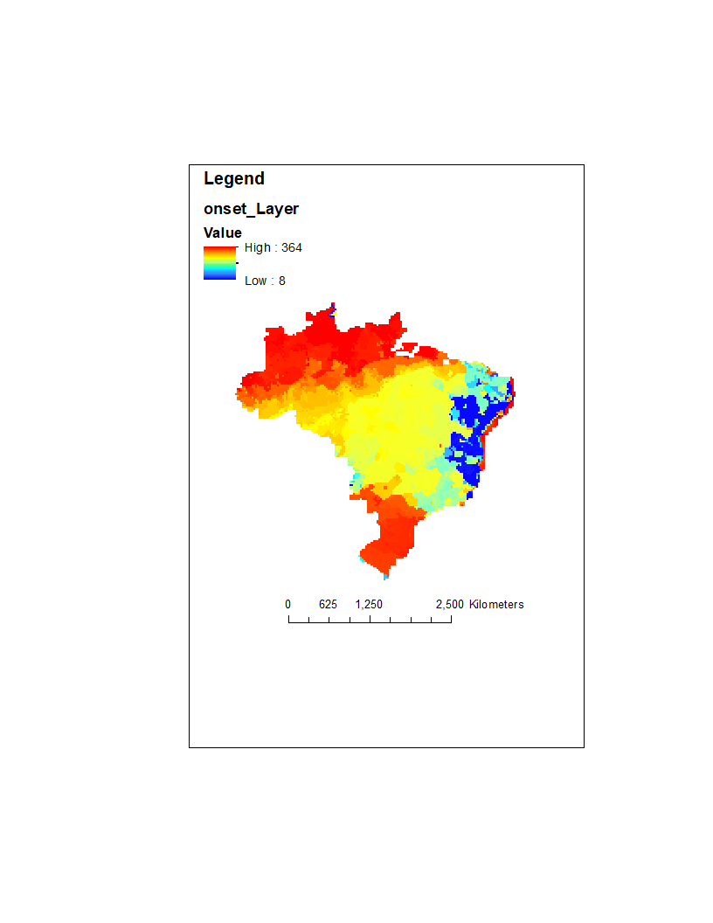
Exploratory data analysis to address challenges
Compare plots for early vs late wet season:
Plant date
Driver 1
Driver 2
Driver 3
Is planting date response linear?
At what spatial scales and temporal scales do unobserved effects become uniform?
Does irrigation make a difference?
Does start of wet season make a difference?
DOY of wet season onset

Slide 27
Exploratory data analysis to address challenges
Compare plots for large vs small properties:
Plant date
Driver 1
Driver 2
Driver 3
Is planting date response linear?
At what spatial scales and temporal scales do unobserved effects become uniform?
Does irrigation make a difference?
Does start of wet season make a difference?
Does property size make a difference?
Notes:
Is property size indicative of access to credit, to information like forecasts, and to access to machinery?

Slide 28
Exploratory data analysis to address challenges
2016
2015
2010
2005
Persistence of spatial trends over time:
The relative importance of time-invariant local characteristics and time-varying climate
Notes:
Other recommended EDA?

Slide 29
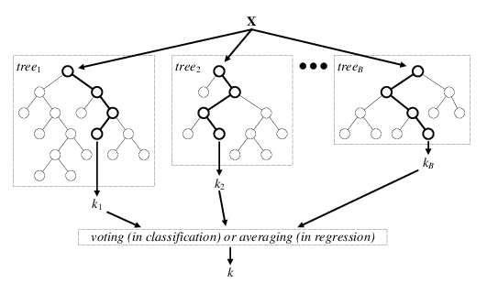
Explore model specifications
OLS regression
plant_{it} = X_{it}β + ε_{it}
Fixed effects regression
plant_{it} = α_{i} + X_{it}β + ε_{it}
Fixed effects (α_{i}) ‘absorb’ unobservable factors
Machine learning (random forest)
https://www.researchgate.net/figure/Architecture-of-the-random-forest-model_fig1_301638643
Notes:
Other model specifications?

Slide 30
The model isn’t a ‘decision to plant’ model; it’s a ‘successful crop’ model
RS indicator of planting
Planting decision
VI timeseries
Error source: only see a certain percent of planting outcome with RS
‘failed crop’ (report from Matopiba) -> percent of pixels that might not be estimated with this method
Look at pixels in a polygon that were bare soil or weeds for the entire growing season for an estimate of crop failure
Anything in the literature?
Calibration error: cross validation gives peak/infl -> plant/harvest error due to ‘wetness’ and temperature during planting time

Slide 31
Challenges for model specification
1. Unobservable controls on planting date
Access to agricultural credit
Availability of farm equipment
Soil type? Influence from neighbors? Agricultural extensions?
2. Relationships depend on planting time
September planting date = f(September rainfall)
November planting date = f(September to November rainfall)
3. Nonlinearities in planting date response
Very dry and very wet months both cause delay in planting
While phytosanitary law applies, planting date is insensitive to other factors
Notes:
For climate variable in regression: how to cope with challenge #2? (assuming that our equation can’t contain anything that farmers can’t observe before planting date, and that we don’t want a regression that depends on knowledge of the planting date)
‘first window of favorable climate’ – but that’s a date…

Slide 32
EDA for OLS model
For a characteristic that matters, e.g. size, do we fit a separate slope on climate for each size category; use it as its own separate explanatory variable; or include an interaction term?
X | Space | Time | Insight | For each:
All, demeaned | All | All | Globally important explanatory variables | Select explanatory variables using forward or ‘reduction’ model selection. Test for nonlinearity: Residuals will show whether there are nonlinear relationships that weren’t captured. If so, use scatterplots to find the nonlinear relationship. Test for multicollinearity: take out one explanatory var at a time; if coeffs of the other vars change a lot, have multicollinearity issue – subset or take it out.
All, demeaned | Five major regions (based on political boundaries and ‘soy spots’) | All | Do the relevant explanatory variables (and their strengths) differ among regions? Do the ‘important’ vars change over space?
All, demeaned | 200km cells in each of the regions; 50km cells in each of the regions | All | Do the coefficients change when the spatial scale changes? Do the ‘important’ vars change over space? What is the appropriate spatial scale to minimize error but still give a reasonable set of equations?
All, except for trend | Five major regions | Groups of 3 years, individual years | Do relationships change over time? (are the coefficients significantly different?) do the ‘important’ vars change over space?

Slide 33
Each model addresses the challenges differently
OLS
Fixed effects
Random forest
No real solution; subset data by time and space to minimize the issue
Time and location fixed effects absorb confounding factors
No real solution; subset data by time and space to minimize the issue
Unobservable controls on planting date
Relationships depend on planting time
Handled in decision tree structure
Careful definition of climate variables, informed by exploratory data analysis
Nonlinearities in planting date response

Slide 34
Defining sensitivity of plant date to climate
Perturbation in climate
Model of planting date behavior
Change in planting date

